Slide 1
Lloyd Harbor School
Spring Concert
2022
Art work by 5th and 6th grade students
Art Teacher – Ms. Andria Mclaughlin

Slide 2
Machu Picchu, Nazca Lines and Llama
Mixed Media

Slide 3
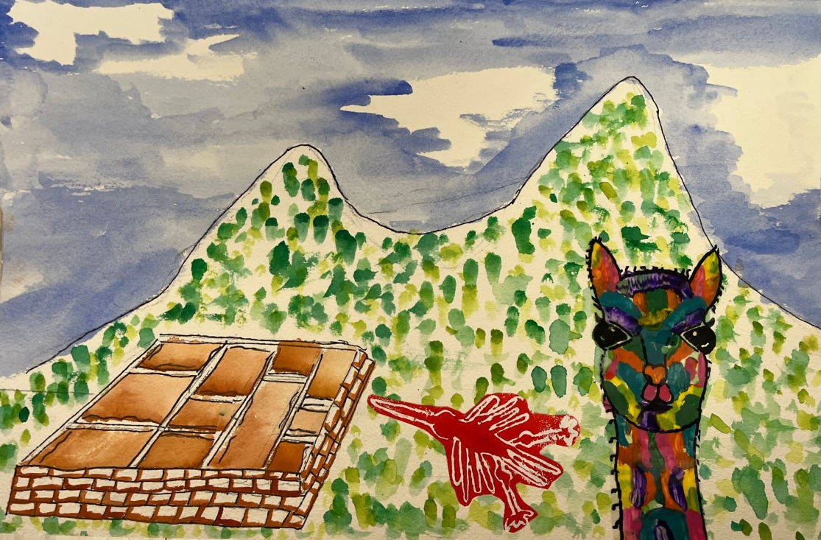

Slide 4
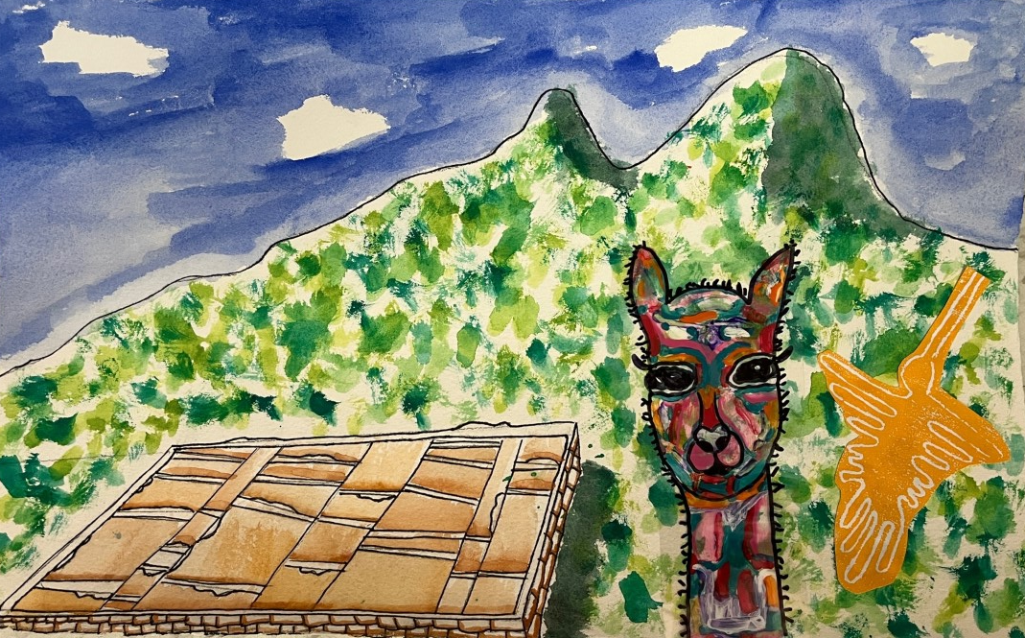

Slide 5
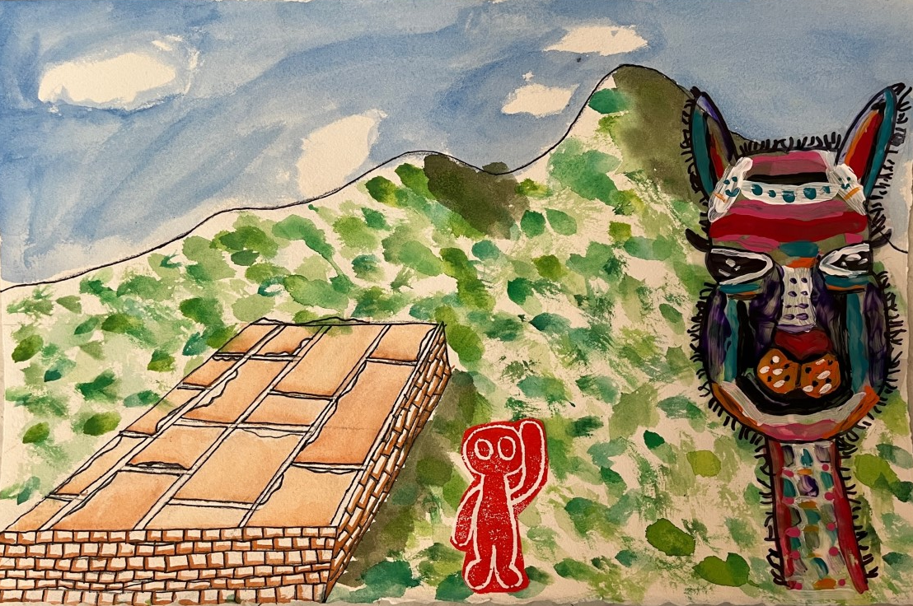

Slide 6
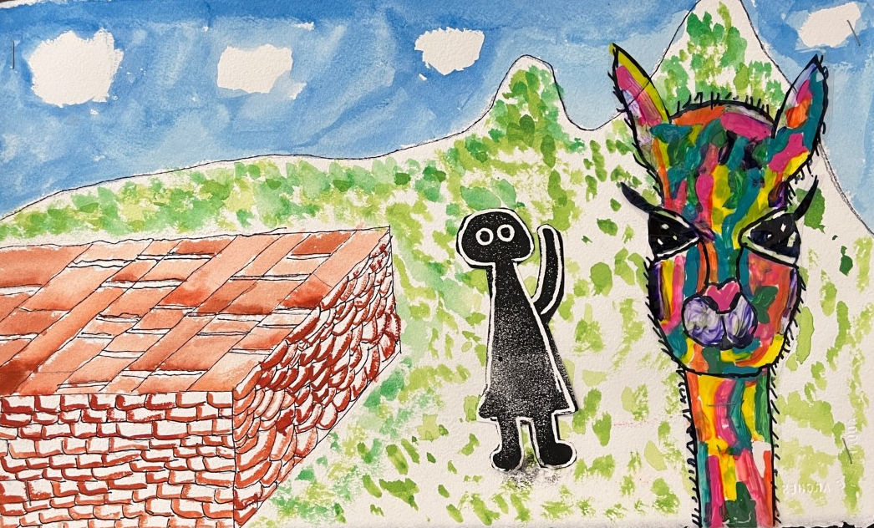

Slide 7
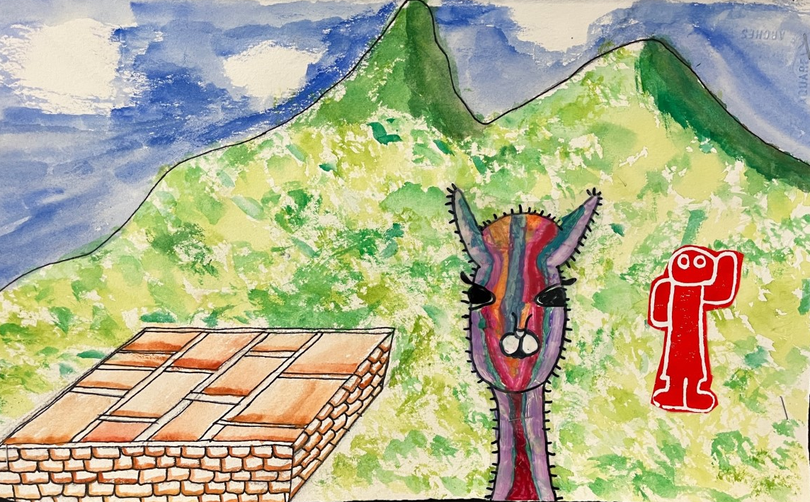

Slide 8
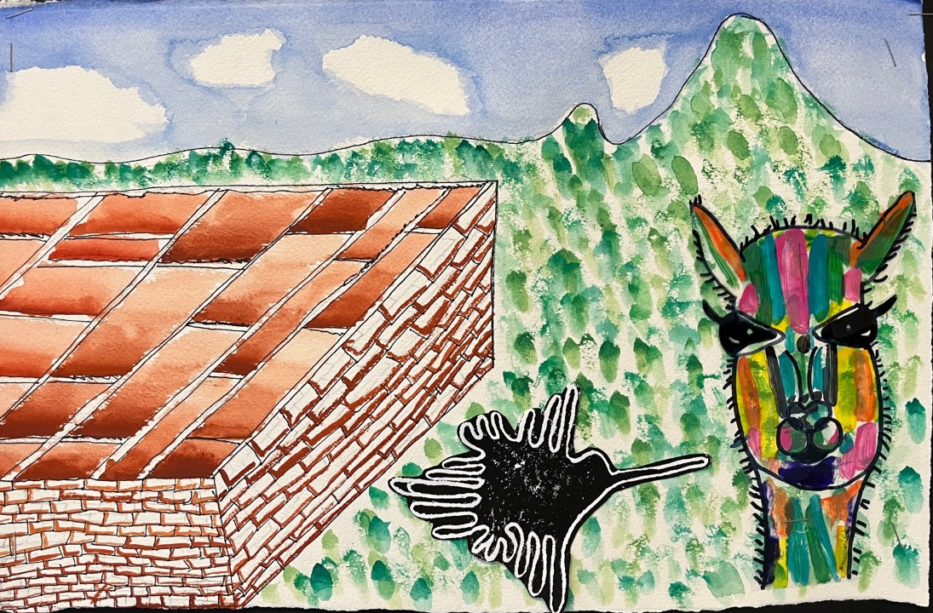

Slide 9
Recycling Desk Shields into POP ART
Acrylic Paint on Plastic

Slide 10
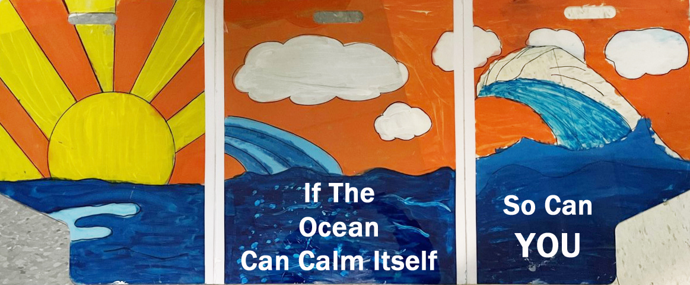

Slide 11
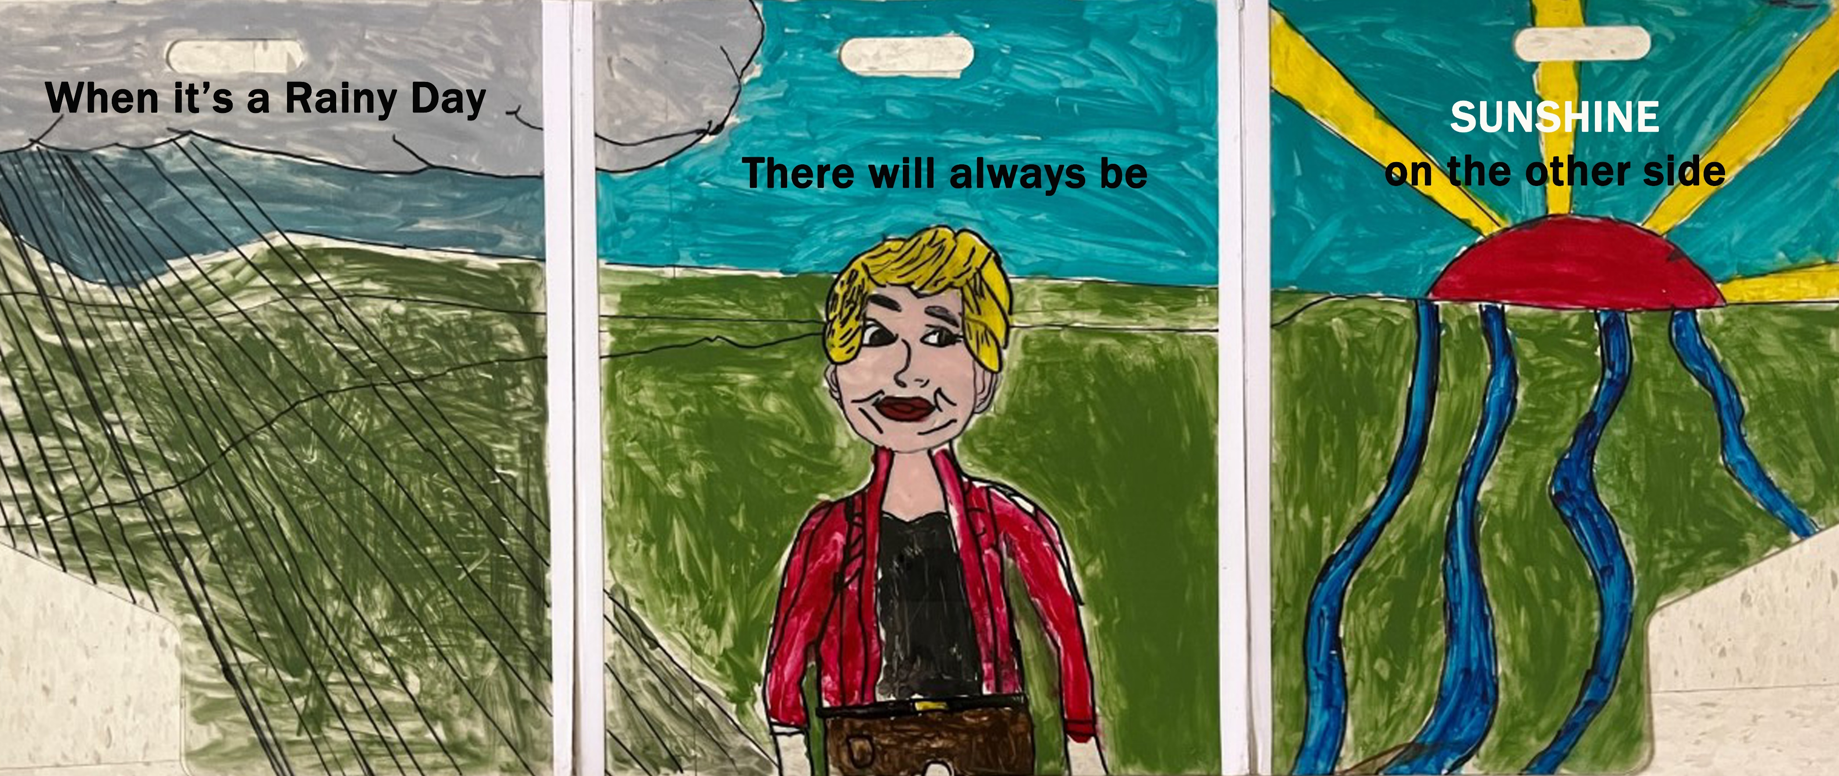

Slide 12
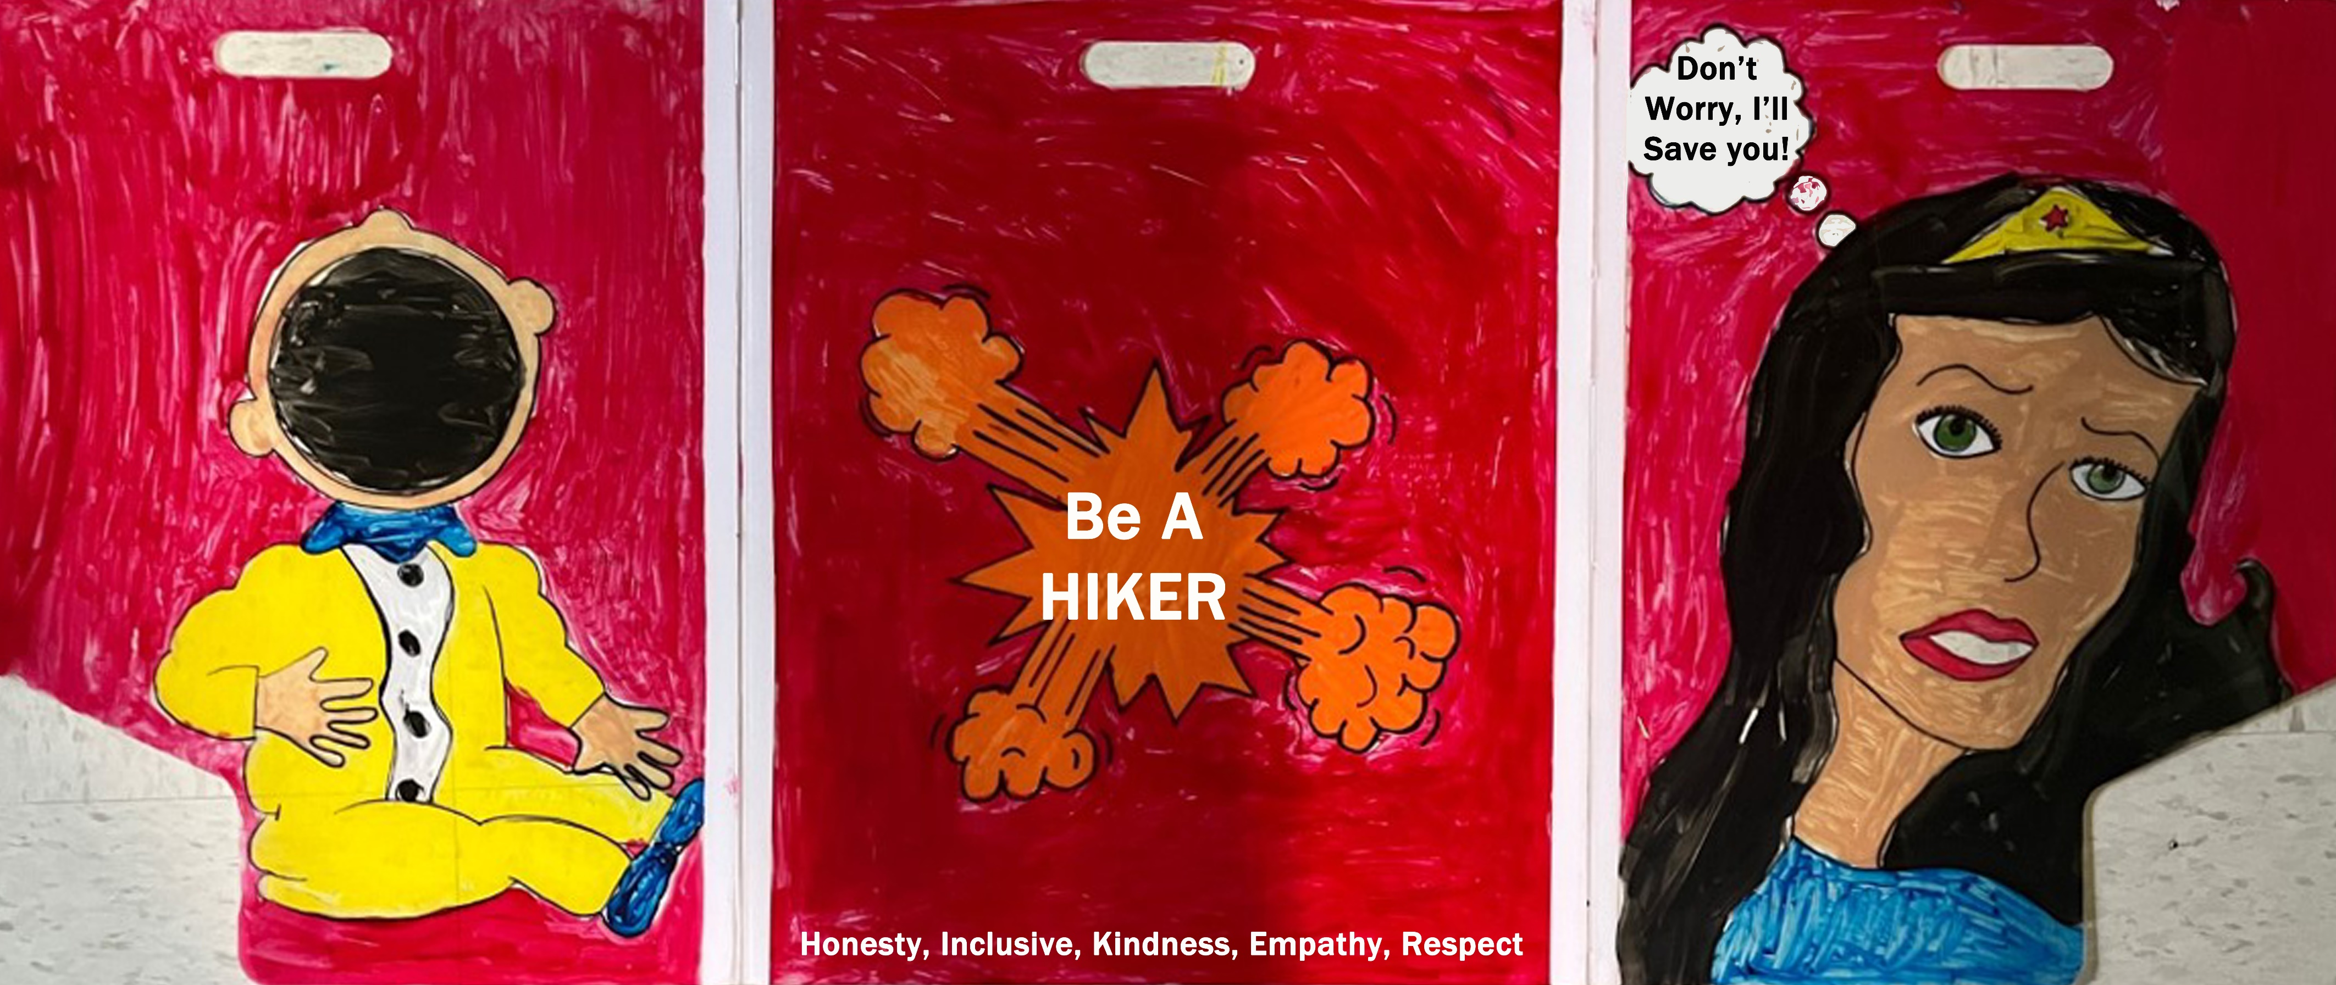

Slide 13
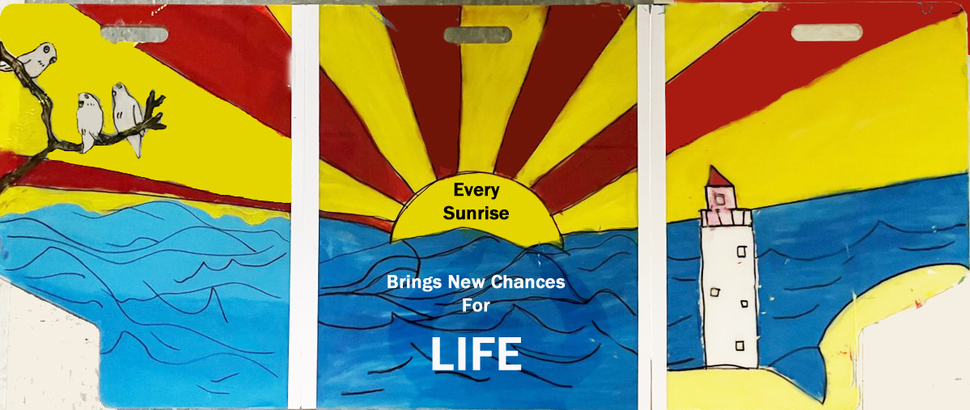

Slide 14
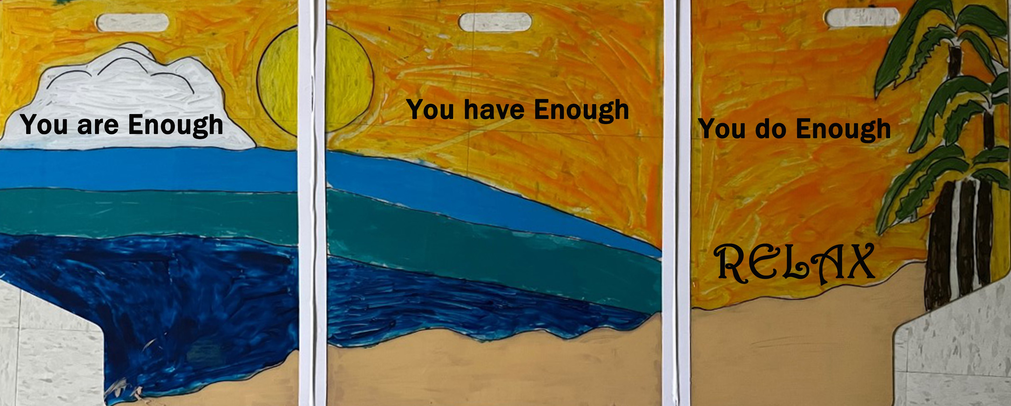

Slide 15
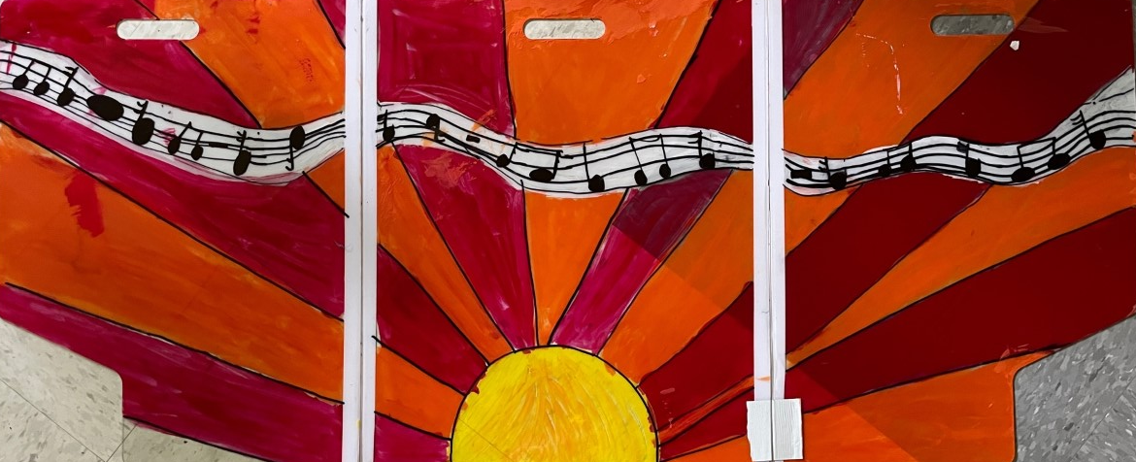
MUSIC
Is
LIFE

Slide 16
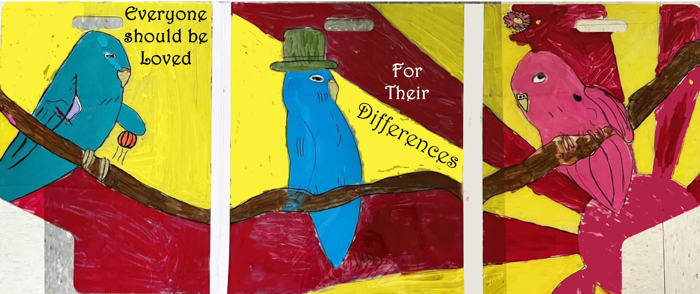

Slide 17
Surreal Sculptures
Acrylic Paint on clay

Slide 18
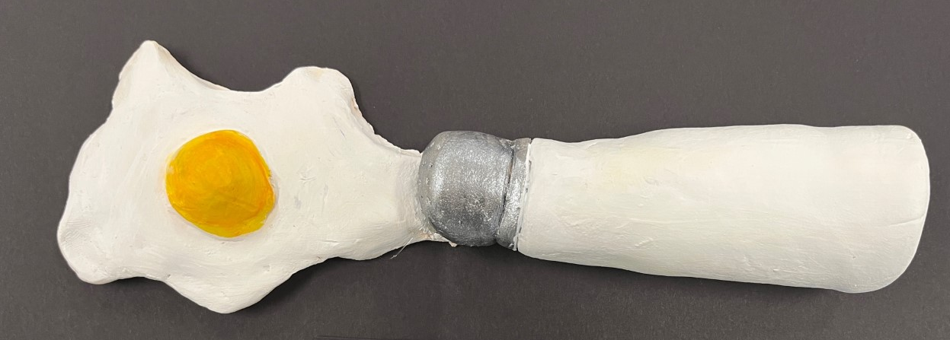

Slide 19
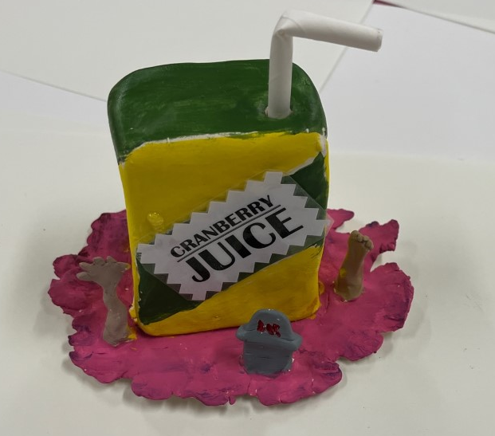

Slide 20
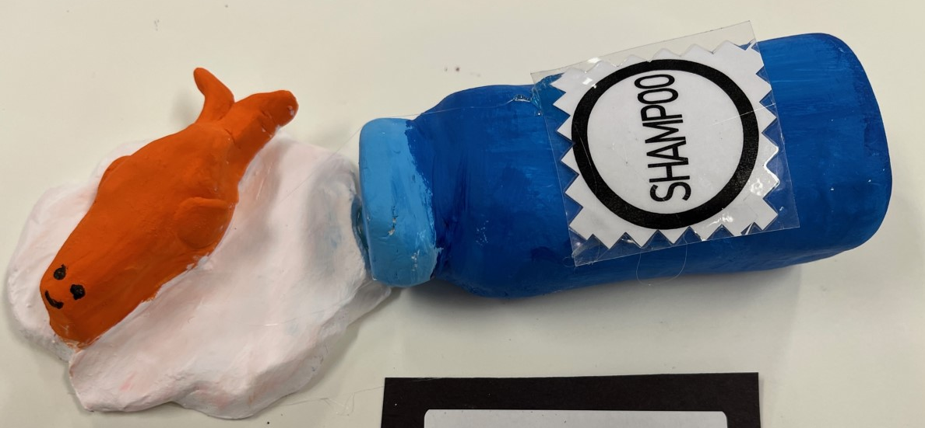

Slide 21
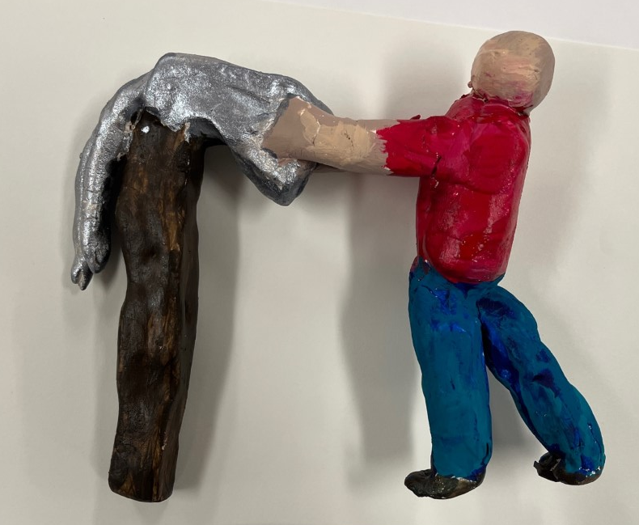

Slide 22
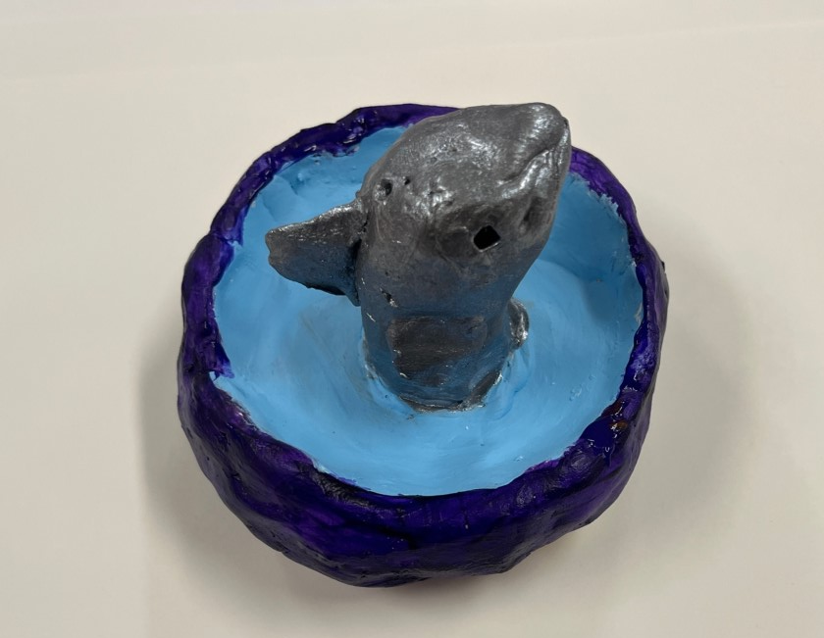

Slide 23
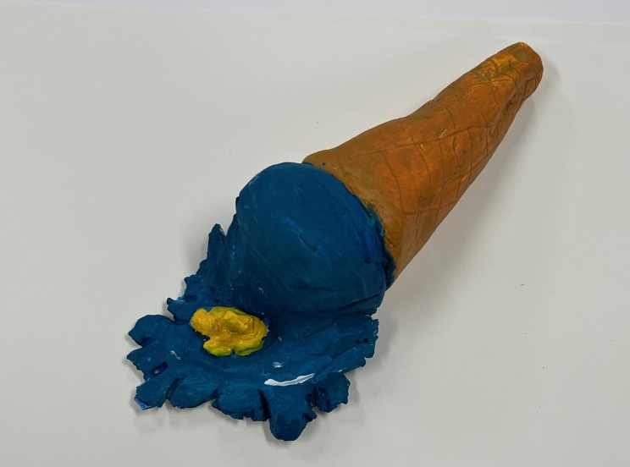

Slide 25
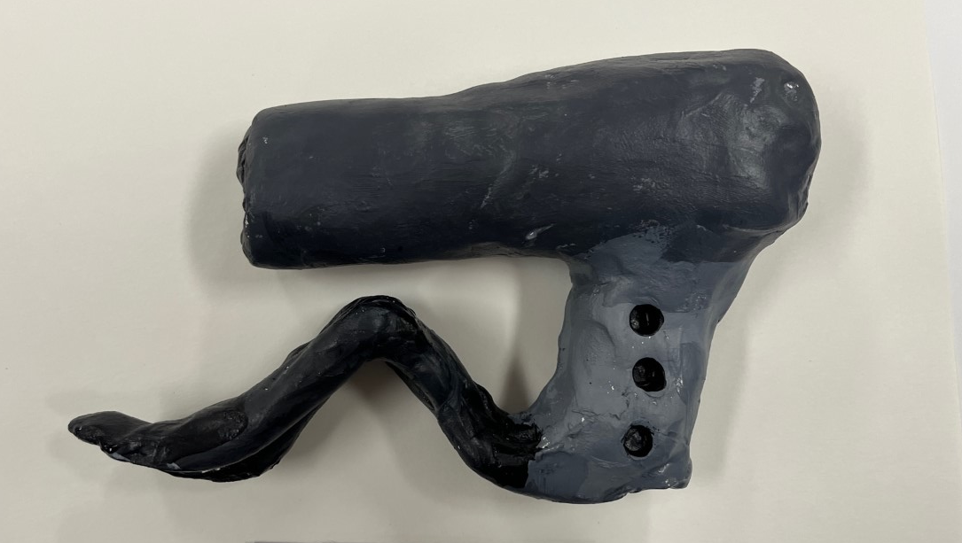

Slide 26
